Slide 1


Graph Representation Learning: A deep learning approach to perform Learning on Graphs
Aniket Saxena
IBM Research, India

Slide 2
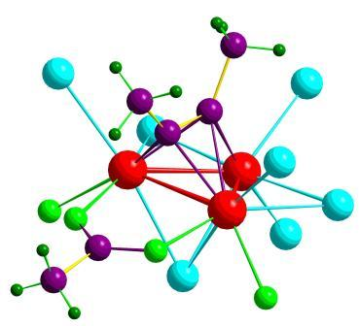
Data as Graphs - Explicit
Social Graphs
Transportation Graphs
Brain Graphs
Web Graphs
Molecular Graphs
Gene Graphs

Slide 3
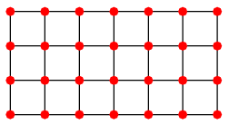
Deep Learning Meets Graphs: Challenges
Traditional DL is designed for simple grids or sequences
CNNs for fixed-size images/grids
RNNs for text/sequences
But nodes on graphs have different connections
Arbitrary neighbor size
Complex topological structure
No fixed node ordering

Slide 4
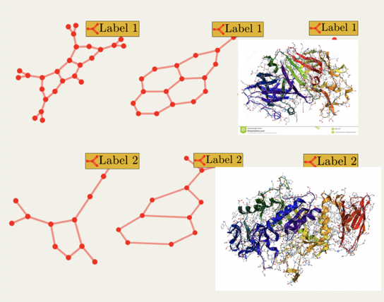
Tasks on Graph-Structured Data
Node-level
Graph-level
Link Prediction
Graph Classification
？
？
t
t+a
Node Classification
？
？
？

Slide 5
Two Main Operations in GNN
Graph Filtering
Graph Filtering
Graph filtering refines the node features

Slide 6
Two Main Operations in GNN
Graph Pooling
Graph Pooling
Graph pooling generates a smaller graph

Slide 7
General GNN Framework
For node-level tasks
Filtering Layer
Activation
…

Slide 8
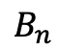
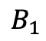
General GNN Framework
For graph-level tasks
Filtering Layer
Activation
Pooling Layer
…
…
…
$$B_{1}$$
$$B_{n}$$

Slide 9

Graph Neural Networks
Representations
Graph-level
Activation Function
Node-level
Graph Convolutions
Graph Convolutions

Slide 10
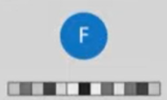
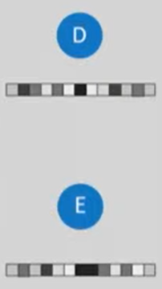
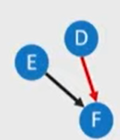
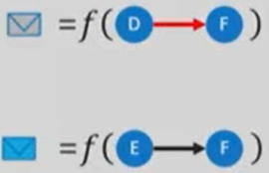


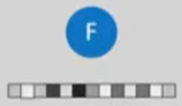
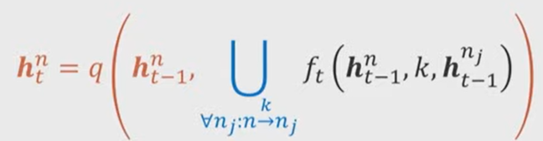
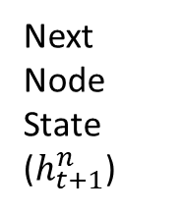
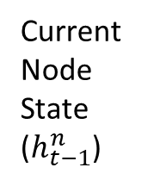
Neural Message Passing
Learned Graph Spectral Filter
Original Graph
Current Neighbor States
Prepare “Message”
Summarize Received Information
Current Node State
($h_{t−1}^{n}$)
Next Node State
($h_{t+1}^{n}$)
Computes

Slide 11
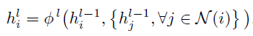
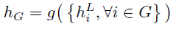
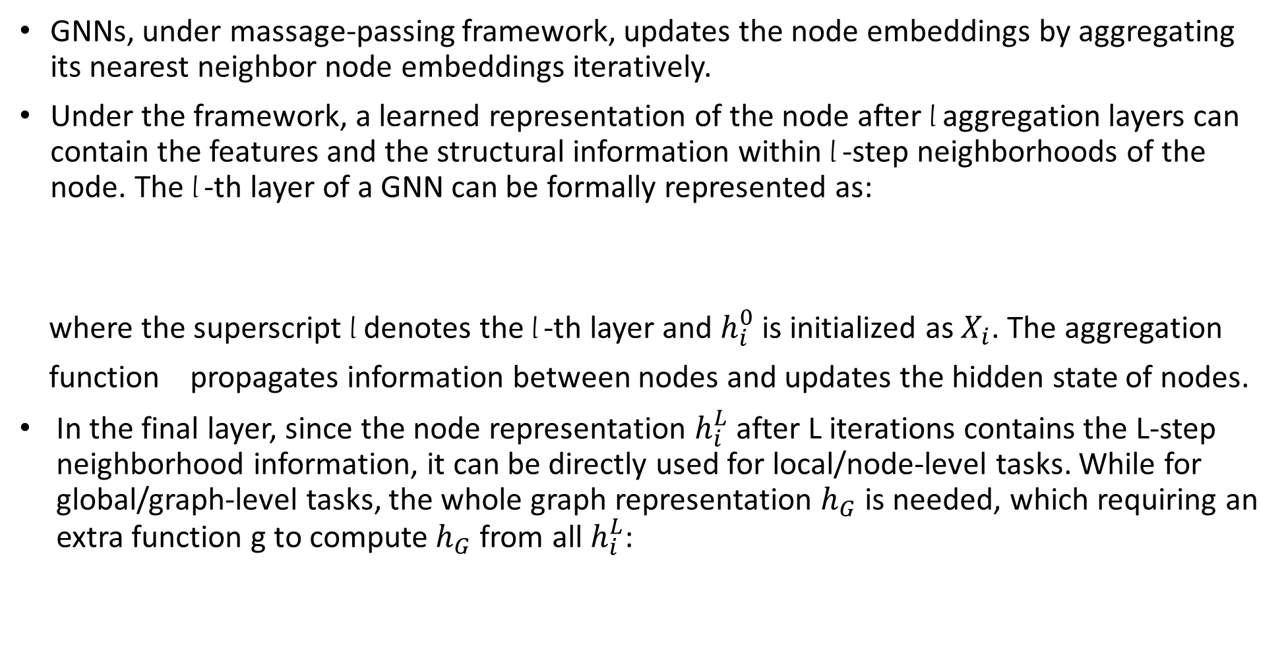
GNN under message-passing framework
GNNs, under massage-passing framework, updates the node embeddings by aggregating its nearest neighbor node embeddings iteratively.
Under the framework, a learned representation of the node after l aggregation layers can contain the features and the structural information within l -step neighborhoods of the node. The l -th layer of a GNN can be formally represented as:
where the superscript l denotes the l -th layer and $h_{i}^{0}$ is initialized as $X_{i}$. The aggregation
function propagates information between nodes and updates the hidden state of nodes.
In the final layer, since the node representation $h_{i}^{L}$ after L iterations contains the L-step neighborhood information, it can be directly used for local/node-level tasks. While for global/graph-level tasks, the whole graph representation $h_{G}$ is needed, which requiring an extra function g to compute $h_{G}$ from all $h_{i}^{L}$:

Slide 12
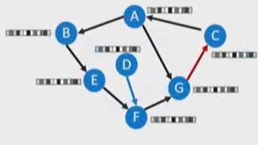
Schematic Diagram of GNN’s Training Process
Task Specific Loss
GNN
Output Representation of each node
Initial Representation of each node

Slide 13
Spectral Filters for advanced GNNs
GCN (Semi-supervised classification graph convolutional networks. ICLR 2017)
GraphSage (Inductive Representation Learning on Large Graphs. NIPS 2017)
where AGG is the aggregation function

Slide 14
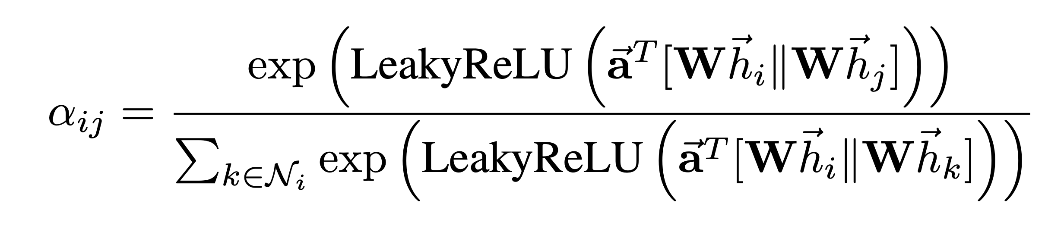
GAT (Graph Attention Networks. ICLR 2018)
MPNN (Neural Message Passing for Quantum Chemistry. ICML 2017)
Message Passing
Feature Updating

Slide 15
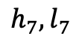
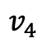
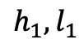
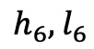
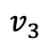
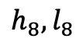
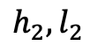
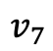
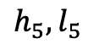
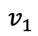
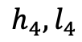
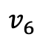
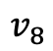
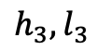
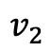
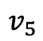
DiffPool
Downsample by clustering the nodes using GNN
$${h_{3},l}_{3}$$
$$v_{3}$$
$$v_{4}$$
$${h_{4},l}_{4}$$
$${h_{1},l}_{1}$$
$$v_{1}$$
$${h_{2},l}_{2}$$
$${h_{5},l}_{5}$$
$$v_{5}$$
$$v_{2}$$
$$v_{8}$$
$${h_{8},l}_{8}$$
$${h_{6},l}_{6}$$
$$v_{6}$$
$$v_{7}$$
$${h_{7},l}_{7}$$
Hierarchical Graph Representation Learning with Differentiable Pooling. NeurIPS 2018

Slide 16
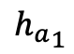
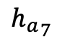
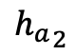
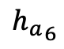
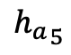
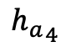
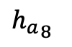
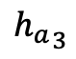
DiffPool
Downsample by clustering the nodes using GNN
2 filters
$${h_{a}}_{3}$$
$$v_{3}$$
$$v_{4}$$
$${h_{a}}_{4}$$
$${h_{a}}_{1}$$
Filter1:
$$v_{1}$$
Generate a soft-assign matrix
$${h_{a}}_{2}$$
$${h_{a}}_{5}$$
$$v_{5}$$
$$v_{2}$$
$$v_{8}$$
$${h_{a}}_{8}$$
$${h_{a}}_{6}$$
$$v_{6}$$
$$v_{7}$$
$${h_{a}}_{7}$$

Slide 17
DiffPool
Downsample by clustering the nodes using GNN
2 filters
$${h_{a}}_{3}$$
$$v_{3}$$
$$v_{4}$$
$${h_{a}}_{4}$$
$${h_{a}}_{1}$$
Filter1:
$$v_{1}$$
Generate a soft-assign matrix
$${h_{a}}_{2}$$
$${h_{a}}_{5}$$
$$v_{5}$$
$$v_{2}$$
$$v_{8}$$
$${h_{a}}_{8}$$
$${h_{a}}_{6}$$
$$v_{6}$$
$$v_{7}$$
$${h_{a}}_{7}$$
Filter2:
Generate new features

Slide 18
DiffPool
Downsample by clustering the nodes using GNN
$${h_{a}}_{3}$$
Generated soft-assign matrix
$$v_{3}$$
$$v_{4}$$
$${h_{a}}_{4}$$
$${h_{a}}_{1}$$
$$v_{1}$$
Generated new features
$${h_{a}}_{2}$$
$${h_{a}}_{5}$$
$$v_{5}$$
$$v_{2}$$
$$v_{8}$$
$${h_{a}}_{8}$$
$${h_{a}}_{6}$$
$$v_{6}$$
$$v_{7}$$
$${h_{a}}_{7}$$

Slide 19
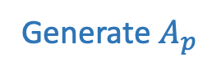
DiffPool
Downsample by clustering the nodes using GNN
$${h_{a}}_{3}$$
Generated soft-assign matrix
$$v_{3}$$
$$v_{4}$$
$${h_{a}}_{4}$$
$${h_{a}}_{1}$$
$$v_{1}$$
Generated new features
$${h_{a}}_{2}$$
$${h_{a}}_{5}$$
$$v_{5}$$
$$v_{2}$$
$$v_{8}$$
$${h_{a}}_{8}$$
$${h_{a}}_{6}$$
Generate $A_{p}$
$$v_{6}$$
$$v_{7}$$
$${h_{a}}_{7}$$

Slide 20

DiffPool
Downsample by clustering the nodes using GNN
$${h_{a}}_{3}$$
Generated soft-assign matrix
$$v_{3}$$
$$v_{4}$$
$${h_{a}}_{4}$$
$${h_{a}}_{1}$$
$$v_{1}$$
Generated new features
$${h_{a}}_{2}$$
$${h_{a}}_{5}$$
$$v_{5}$$
$$v_{2}$$
$$v_{8}$$
$${h_{a}}_{8}$$
$${h_{a}}_{6}$$
Generate $A_{p}$
$$v_{6}$$
$$v_{7}$$
$${h_{a}}_{7}$$
Generate $H_{p}$

